Slide 1

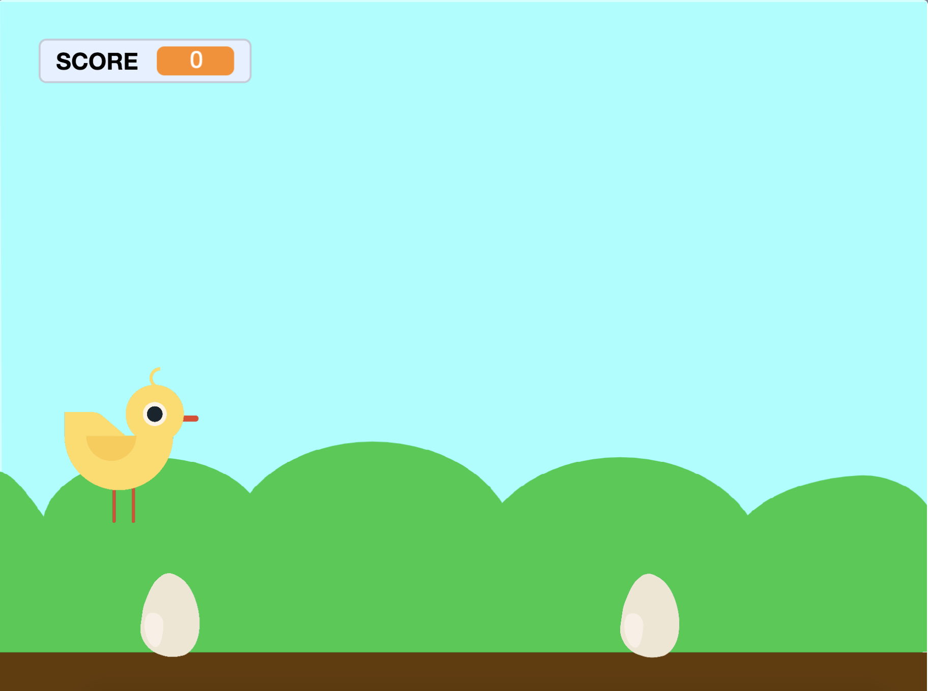


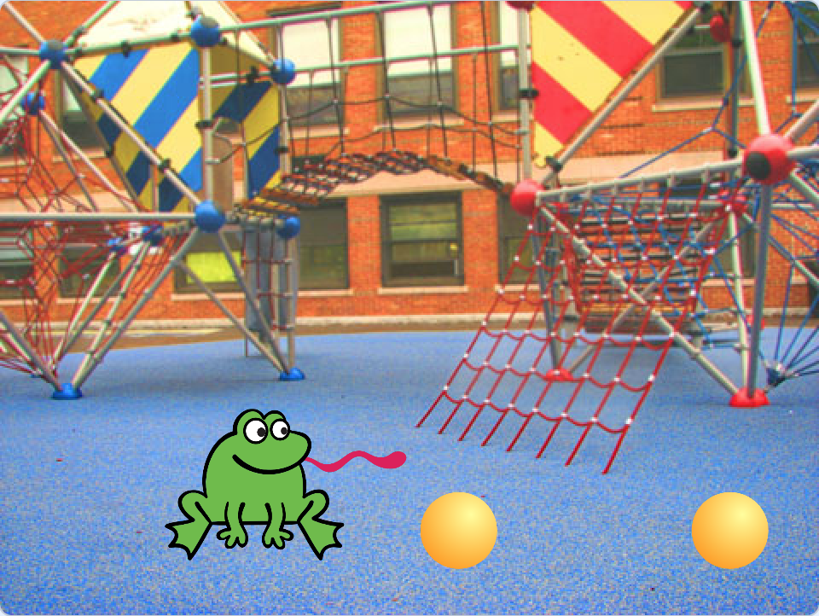


Jumping Game Cards
Make a character jump over moving obstacles.
yyyymmdd
scratch.mit.edu
Set of 7 cards

Slide 2
Jumping Game Cards
Use these cards in this order:
Jump
Go to Start
Moving Obstacle
Add a Sound
Stop the Game
Add More Obstacles
Score
scratch.mit.edu
Set of 7 cards

Slide 3

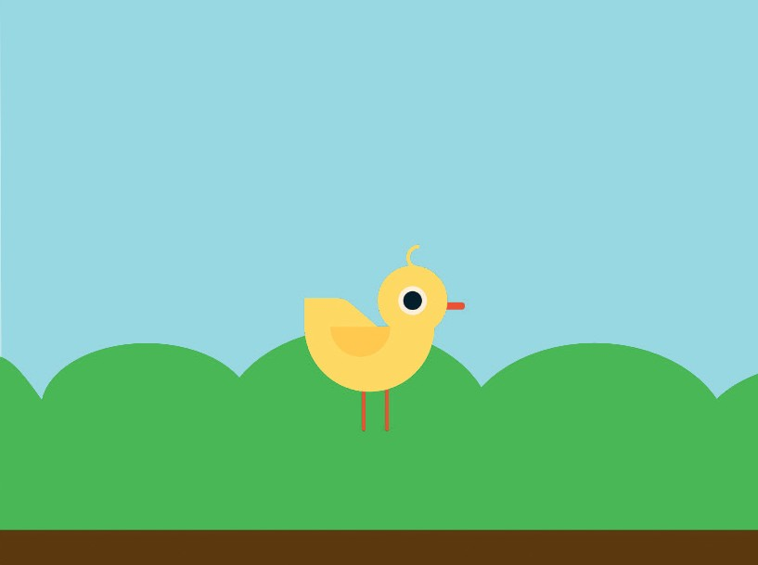


Jump
Make a character jump.
yyyymmdd
Jumping Game
1

Slide 4




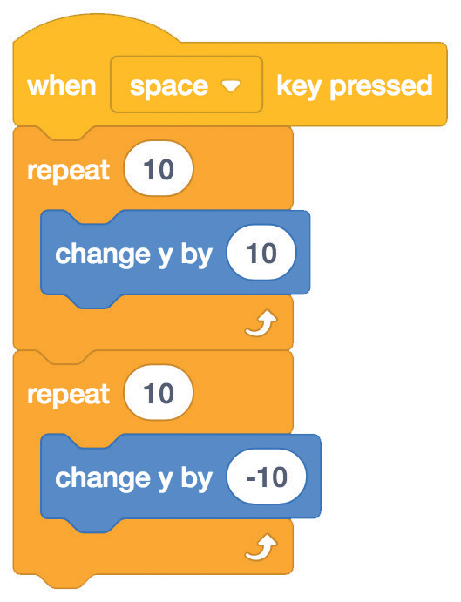

Jump
scratch.mit.edu
GET READY
Choose a backdrop.
Blue Sky
Choose a character, like Chick.
Chick
ADD THIS CODE
Chick
Type a minus sign to go back down.
TRY IT
Press the space key on your keyboard.

Slide 5

Go to Start
Set the starting point for your sprite.
yyyymmdd
Jumping Game
2

Slide 6

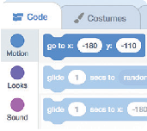

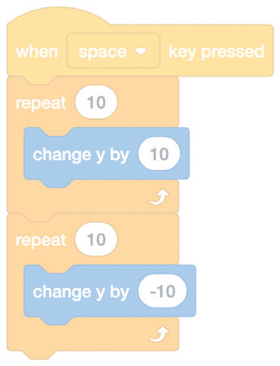
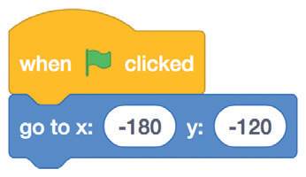

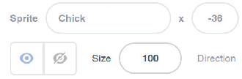





Go to Start
scratch.mit.edu
GET READY
When you move your character, its x and y position will update in the blocks palette.
Drag your character to where you want it.
Now when you drag out a go to block, it will set to your character’s new position.
ADD THIS CODE
Chick
Set the starting position.
(Your numbers may be different.)
TIP
Change the size of a sprite by typing a smaller or larger number.

Slide 7
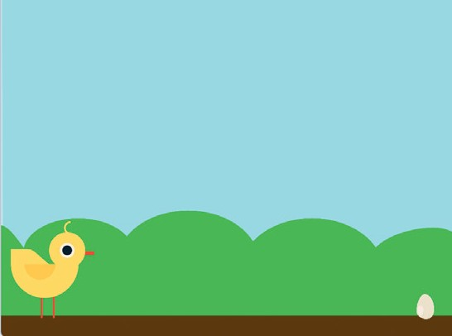
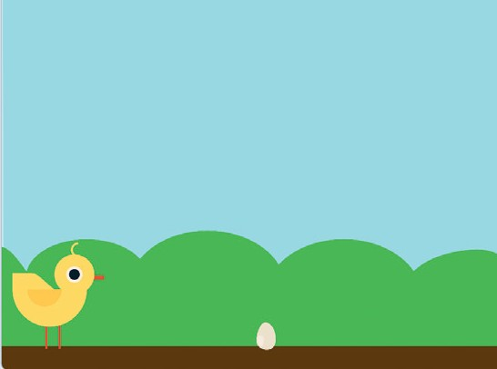
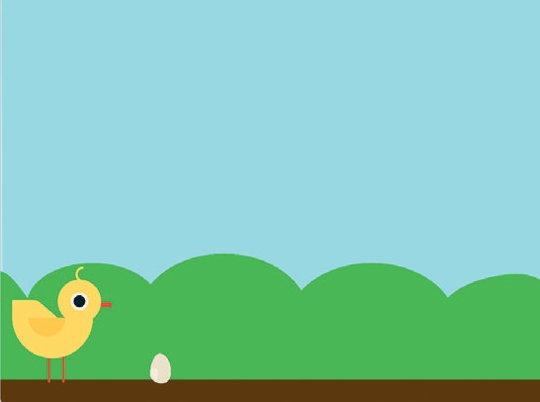
Moving Obstacle
Make an obstacle move across the Stage.
yyyymmdd
Jumping Game
3

Slide 8

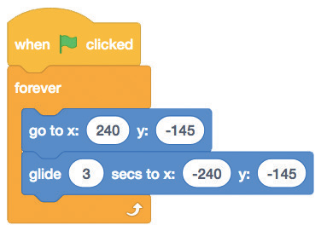


Moving Obstacle
scratch.mit.edu
GET READY
Choose a sprite to be an obstacle, such as Egg.
Egg
ADD THIS CODE
Egg
Start at the right edge of the Stage.
Glide to the left edge of the Stage.
Type a smaller number to go faster.
TRY IT
Click the green flag to start.
Press the space key on your keyboard.

Slide 9
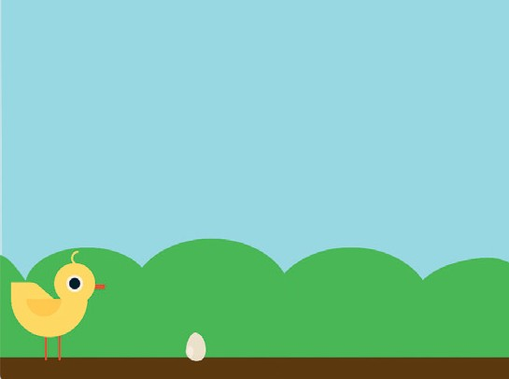


Add a Sound
Play a sound when your sprite jumps.
yyyymmdd
Jumping Game
4

Slide 10
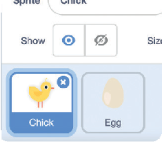

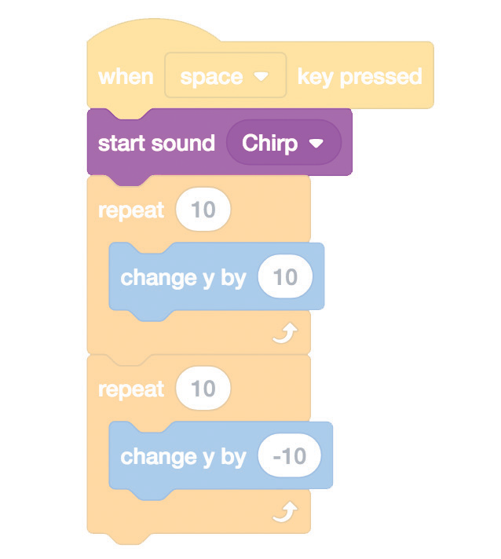
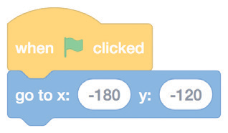
Add a Sound
scratch.mit.edu
GET READY
Click to select the Chick sprite.
ADD THIS CODE
Chick
Add the start sound block, and then select a sound.
TRY IT
Click the green flag to start.
Press the space key on your keyboard.

Slide 11
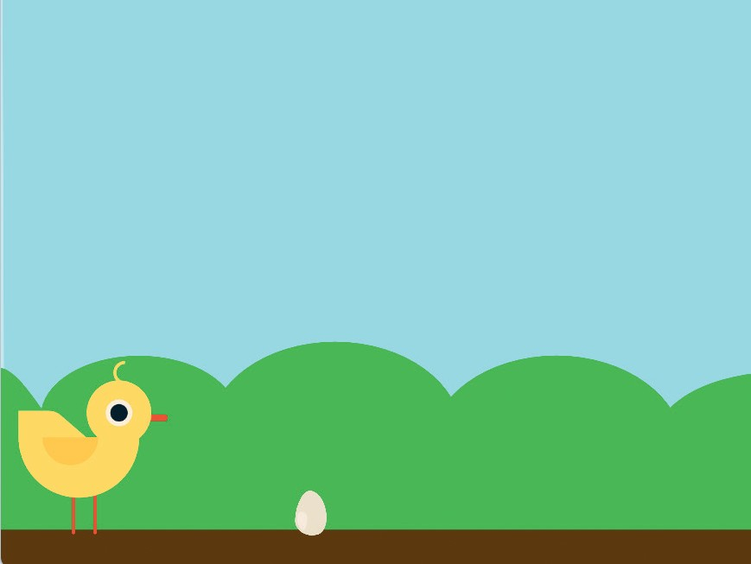

Stop the Game
Stop the game if your sprite touches the egg.
yyyymmdd
Jumping Game
5

Slide 12

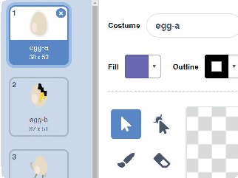
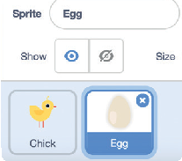

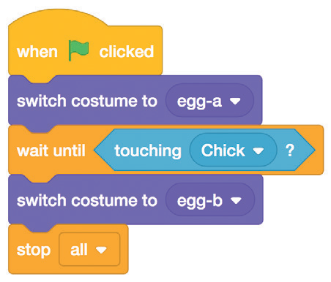
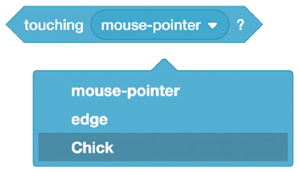

Stop the Game
scratch.mit.edu
GET READY
Click to select the Egg sprite.
Click the Costumes tab to see the Egg sprite’s costumes.
ADD THIS CODE
Click the Code tab and add this code.
Insert the touching block and choose Chick from the menu.
Egg
Choose a second costume for the Egg sprite to change to.
TRY IT
Click the green flag to start.
Press the space key on your keyboard.

Slide 13
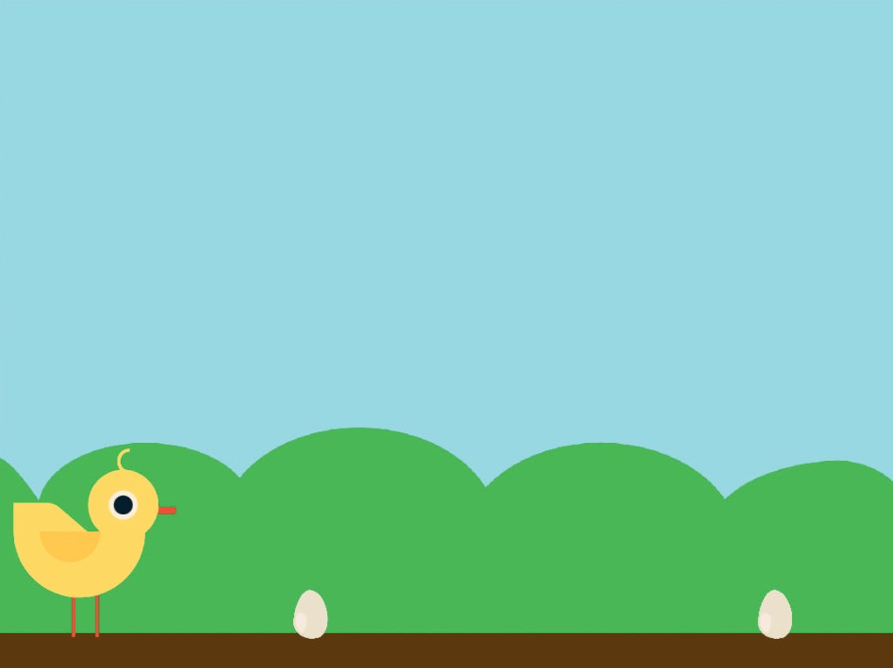
Add More Obstacles
Make the game harder by adding more obstacles.
yyyymmdd
Jumping Game
6

Slide 14
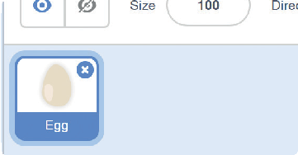
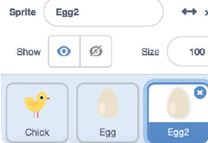
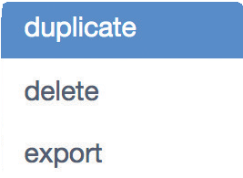
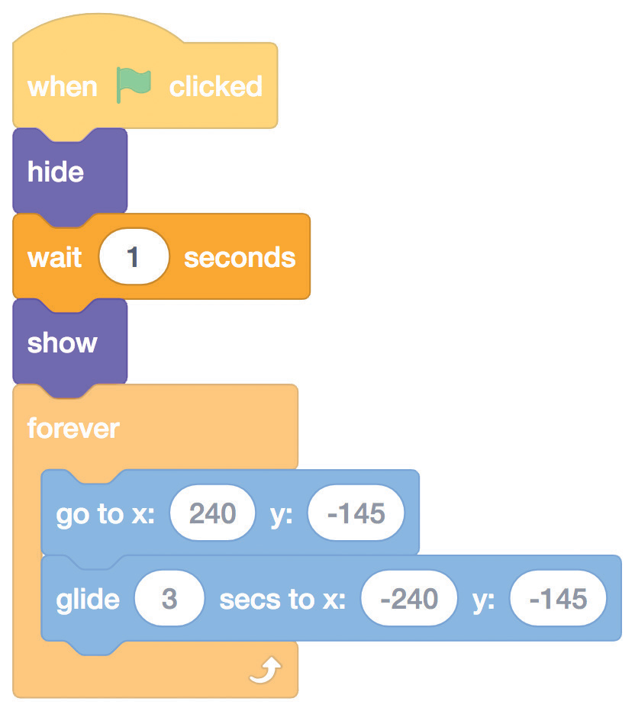

Add More Obstacles
scratch.mit.edu
GET READY
To duplicate the Egg sprite, right- click (Mac: control-click) on the thumbnail, and then choose duplicate.
Click to select Egg2.
ADD THIS CODE
Egg2
Add these blocks to wait before showing the second egg.
TRY IT
Click the green flag to start.

Slide 15
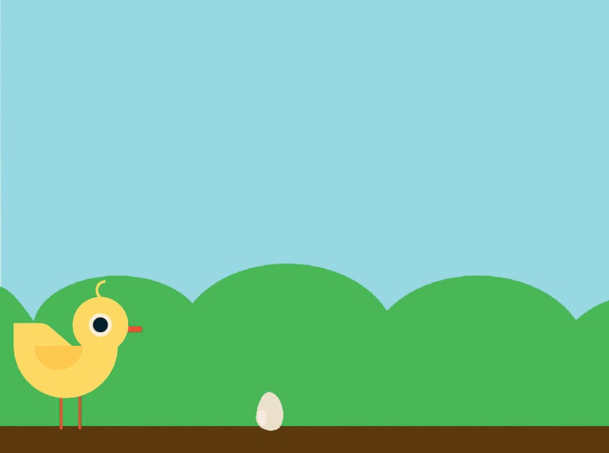
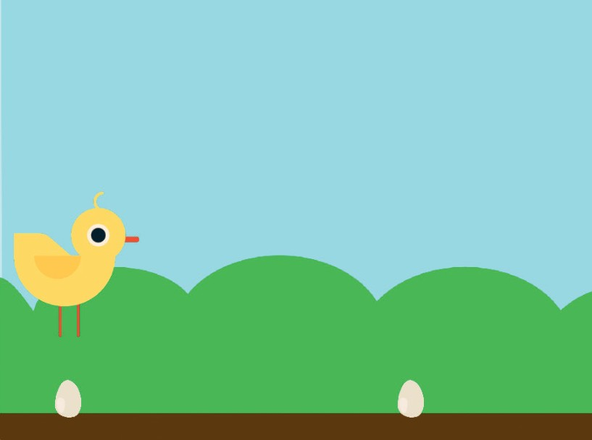
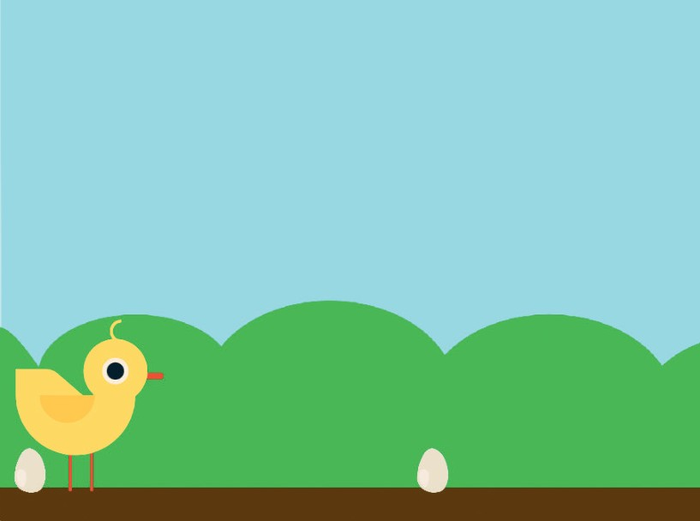
Score
Add a point each time your sprite jumps over an egg.
yyyymmdd
Jumping Game
7

Slide 16
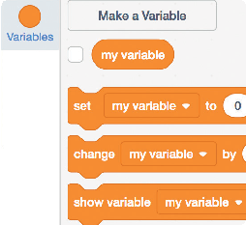
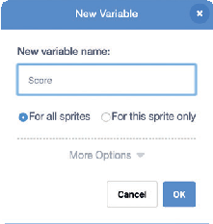
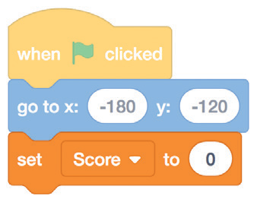
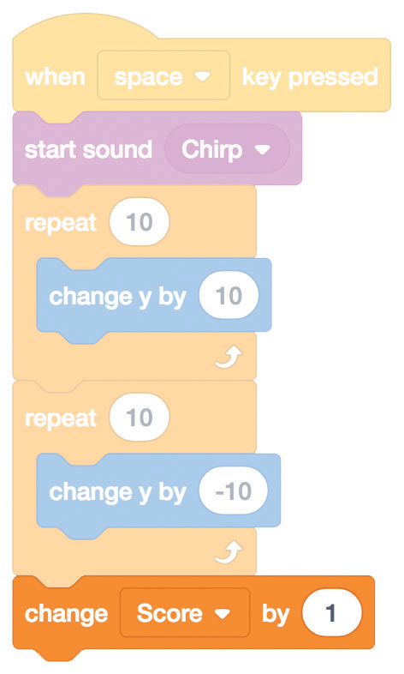
Score
scratch.mit.edu
GET READY
Choose Variables.
Click the Make a Variable button.
Score
Name this variable Score and then click OK.
ADD THIS CODE
Click the Chick sprite and add two blocks to your code:
Chick
Add this block and then choose Score from the menu.
Add this block to increase the score.
Choose Score from the menu.
TRY IT
Jump over the eggs to score points!

